Slide 1
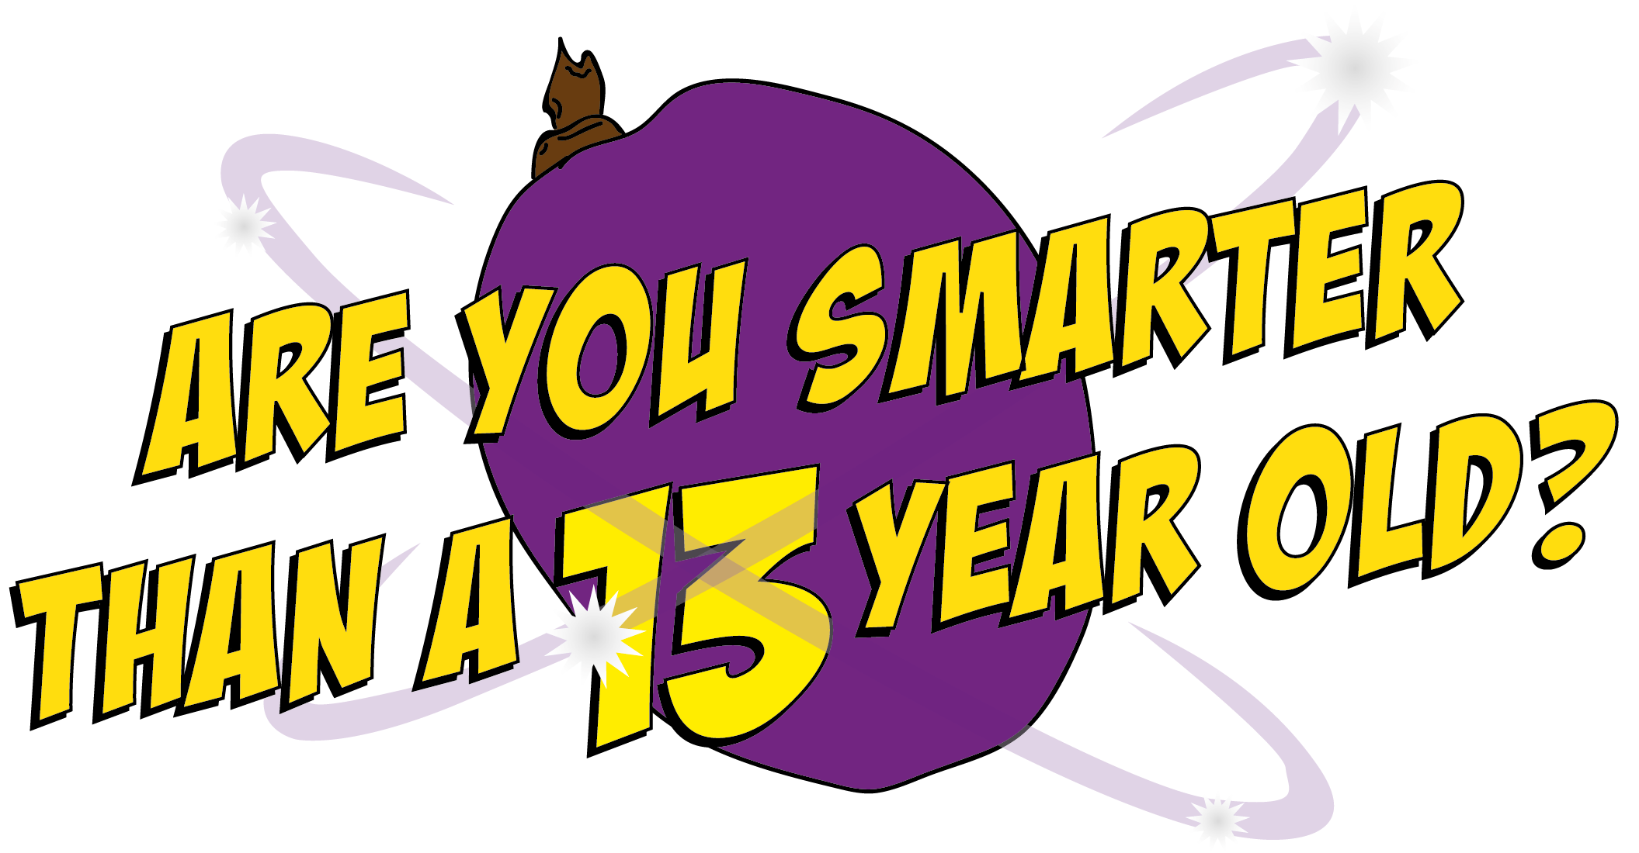


Slide 2
Question 1

Slide 3
What causes the changes that happen in the body during puberty?
A. Your height
C. Your Hormones
D. Your chocolate intake
B. Your age

Slide 4
What causes the changes that happen in the body during puberty?
A. Your height
C. Your Hormones
D. Your chocolate intake
B. Your age

Slide 5
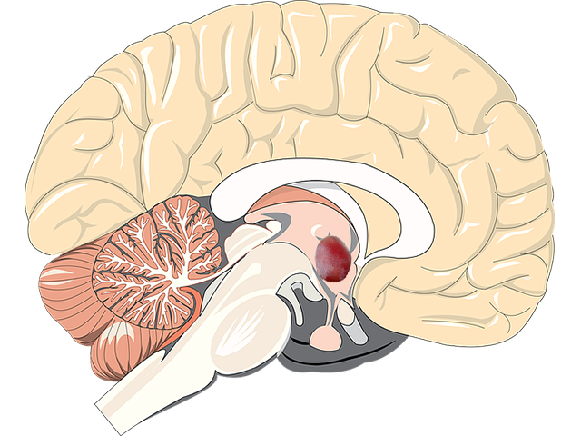
Trigger Hormones
All the changes that happen during puberty are caused by hormones. A part of your brain, about the size of a grape, called the hypothalmus, is responsible for producing the hormone that triggers puberty and the production of more new hormones, which are responsible for the main physical changes to your body.
Hypothalmus

Slide 6
Question 2

Slide 7
Oestrogen and progesterone are the main female hormones produced in the…
A. Ovaries
C. Kidneys
B. Stomach
D. Brain

Slide 8
Oestrogen and progesterone are the main female hormones produced in the…
A. Ovaries
C. Kidneys
B. Stomach
D. Brain

Slide 9
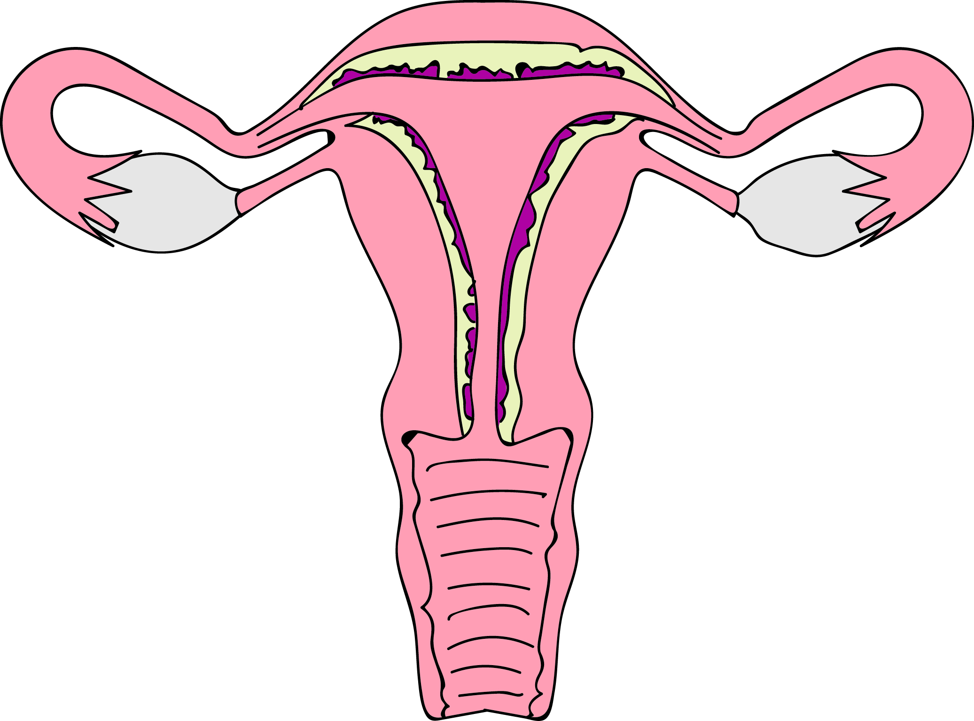
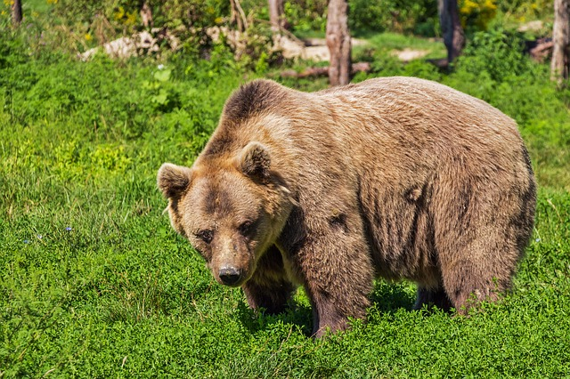
Trigger Hormones
The main sex hormones in girls are called oestrogen and progestorone. They are produced in the ovaries. They cause your breasts to develop, your hips and shoulders to widen, they kick start your periods and make your body hair sprout.

Slide 10
Question 3

Slide 11
Which of these is not another word or phrase for periods?
A. Menstruation
C. Being ‘on’
B. Time of the month
D. Party time

Slide 12
Which of these is not another word or phrase for periods?
A. Menstruation
C. Being ‘on’
B. Time of the month
D. Party time

Slide 13
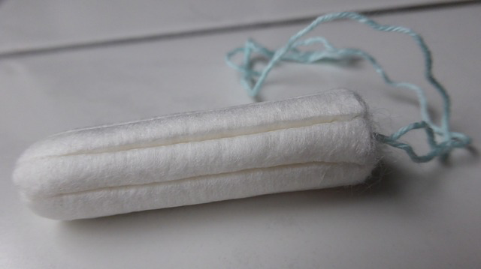
Periods
Starting your periods is a big change that happens during puberty. Periods last for five days on average each month, when some blood comes out of your vagina. This is caused by the release of an egg every twenty eight days from your ovaries, where all the eggs are stored, and it travelling down the fallopian tube where it sits for a few days before being released, along with the uterus lining which has also thickened at the same time.

Slide 14
Periods
This dark blood trickles from the your vagina and is known technically as menstruation. Most girls start their periods between the ages of nine and fifteen. You will then have a period once a month until you are no longer able to have babies (around fifty years old). The blood from a period starts coming out slowly, so don’t worry that you will suddenly flood everywhere! It may seem like more, but you actually only lose two to three tablespoons of blood over a whole period.

Slide 15
Question 4

Slide 16
Which of these is not a sanitary product?
A. A tampon
C. A pad
B. A towel
D. A flush

Slide 17
Which of these is not a sanitary product?
A. A tampon
C. A pad
B. A towel
D. A flush

Slide 18

Sanitary Hygiene
The blood from your period should be soaked up by using sanitary towels (pads) or tampons. Tampons are tightly wound rolls of material, which are very absorbent, with a string attached so you can easily remove them. They are pushed up inside your vagina and, once inserted, you can’t feel them. They need to be changed regularly.

Slide 19
Sanitary Hygiene
The advantage of using tampons is that you can still swim when you are having a period. Towels or pads sit inside your knickers and soak up the blood as it leaves your vagina. They come in different thicknesses and most have sticky side flaps to help keep them in position. You will need to change your towel frequently during the day, depending on how heavy your blood flow is.

Slide 20
Question 5

Slide 21
Which of these is not a sexual orientation?
A. Heterosexual
C. Celibate
B. Bisexual
D. Homosexual

Slide 22
Which of these is not a sexual orientation?
A. Heterosexual
C. Celibate
B. Bisexual
D. Homosexual

Slide 23


Sexuality
Sexual orientation is not something you choose. It is just the way you are. It is about who you find attractive. Some boys know from an early age that they are only attracted to other boys (homosexual or gay). Others experiment to find out what their preference is and a lot of people are unsure. There are people who are celibate and that means they don’t have sex at all.

Slide 24
Question 6

Slide 25
What is homophobia?
C. Hate and abuse towards gay people
A. A fear of sex
D. Hate and abuse towards old people
B. A fear of spiders

Slide 26
What is homophobia?
C. Hate and abuse towards gay people
A. A fear of sex
D. Hate and abuse towards old people
B. A fear of spiders

Slide 27
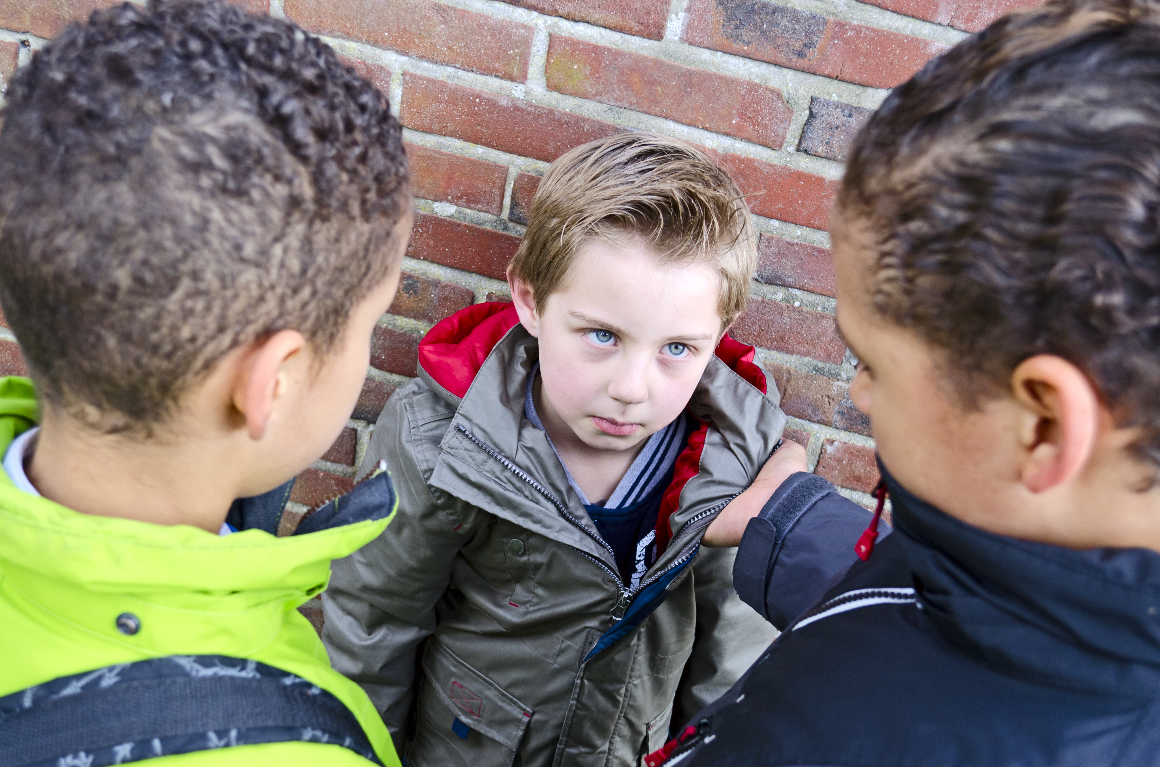
Bullying Behaviour
Homophobia causes a lot of misery and suffering. Homophobic behaviour includes teasing, name-calling, pushing, hitting and tormenting someone simply because of their sexual orientation. “That’s so gay!” might seem like a harmless thing to say but it reinforces the idea that being gay is not a good thing.

Slide 28
Question 7

Slide 29
Which of these terms is not related to having sex?
A. Legal highs
C. Going all the way
B. Sleeping with someone
D. Having intercourse

Slide 30
Which of these terms is not related to having sex?
A. Legal highs
C. Going all the way
B. Sleeping with someone
D. Having intercourse

Slide 31
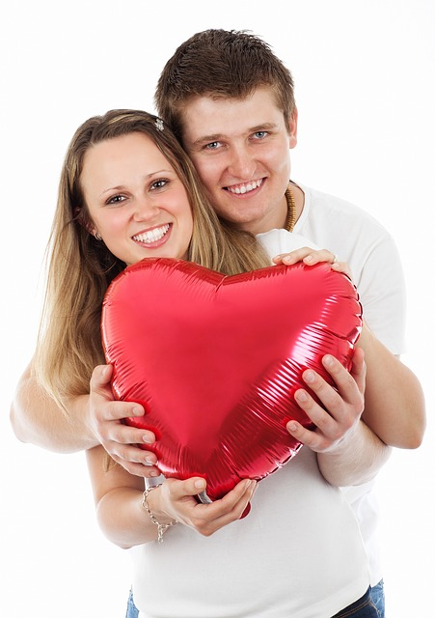
Let’s Talk About Sex!
Puberty for a girl is quite similar to a boy, except their breasts become bigger, they start their periods and their sex organs develop. Breasts make a girl look grown up and attractive and they make milk for their babes, too. Periods involve women releasing an egg every month from their ovaries, where all the eggs are stored, and it travelling down the fallopian tube where it sits for a few days before being released, along with the uterus lining which has also thickened at the same time.

Slide 32
Let’s Talk About Sex!
This dark blood trickles from the woman’s vagina and is known technically as menstruation. You start to become a sexual person when you go through puberty. This doesn’t mean you are ready to have sex just because you can, though! People have sex or ‘make love’ because they feel deeply attracted to or are in love with someone. People can be sexual with each other in lots of ways. When two people give each other an orgasm this can also be described as ‘having sex’. When a man and a woman have sex, it usually means the man’s erect penis goes inside the woman’s vagina and he ejaculates.

Slide 33
Question 8

Slide 34
A woman shouldn’t get pregnant if…
A. She is having her period
C. Contraception is used
D. It’s their first time for sex
B. She doesn’t orgasm

Slide 35
A woman shouldn’t get pregnant if…
A. She is having her period
C. Contraception is used
D. It’s their first time for sex
B. She doesn’t orgasm

Slide 36
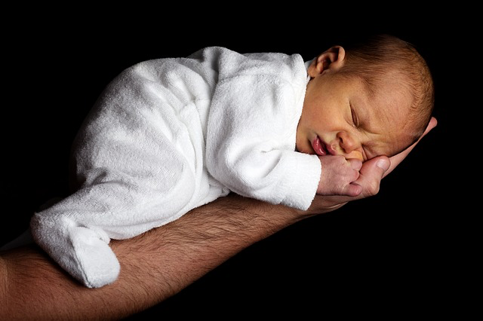
Making Babies
Babies are made when a single sperm from a man joins together with a woman’s egg, which can happen after sex unless the man is wearing a condom. Wearing a condom is a form of contraception. Contraception allows a man and a woman to prevent pregnancy when they have sex. Condoms also prevent the spread of infections known as STIs (sexually transmitted infections). If you really love someone and want to have sex with them, you should be willing to wear a condom.

Slide 37
Question 9

Slide 38
Pornography is mainly accessed through…
A. DVD
C. Internet
B. Magazines
D. Cinema

Slide 39
Pornography is mainly accessed through…
A. DVD
C. Internet
B. Magazines
D. Cinema

Slide 40

Porn Stars
Pornography usually means photos and videos of people getting naked, having all kinds of sex and masturbating. Porn can be disturbing and seeing it might make you feel uncomfortable or strange. Accessing porn through the internet can put your computer at risk of viruses, as well as meaning you may stumble across nasty images, which may even be illegal! Porn is not reality and sex in real life is not like in porn films. Remember, you don’t have to look at porn and you’re not odd if you don’t.

Slide 41
Question 10

Slide 42
Which of these is true?
A. The average age when people first have sex is 17
C. Sex standing up prevents pregnancy
B. You only need to start wearing a bra when your periods start
D. Underarm hair keeps on growing if you don’t shave

Slide 43
Which of these is true?
A. The average age when people first have sex is 17
C. Sex standing up prevents pregnancy
B. You only need to start wearing a bra when your periods start
D. Underarm hair keeps on growing if you don’t shave

