Slide 1

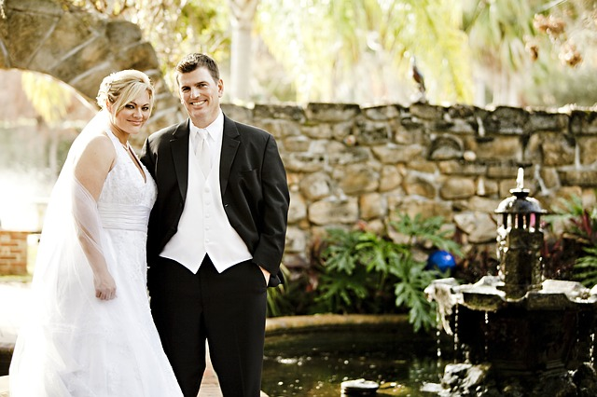
What Makes a Healthy Relationship?

Slide 2
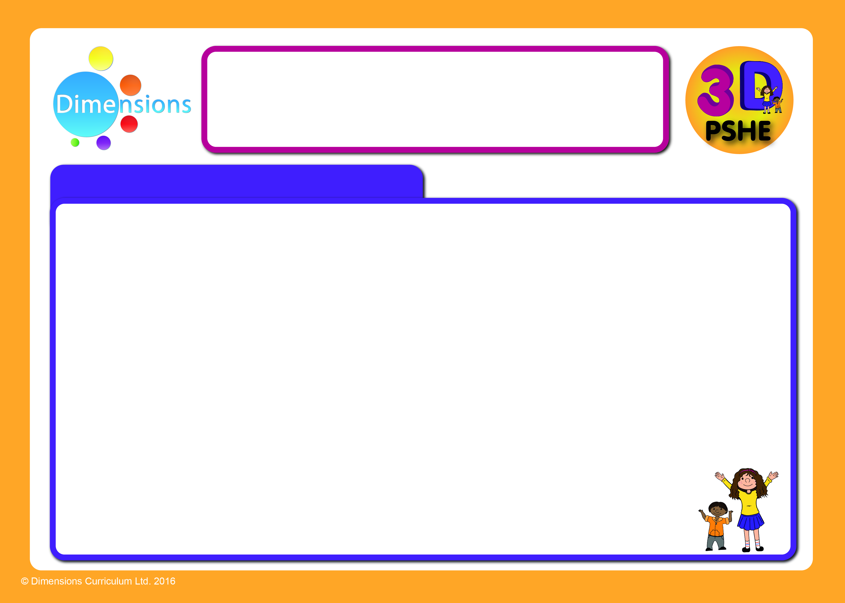

Trust
You're talking to someone your best
friend doesn’t like. Does he call you for
it, wondering if you’re talking about
him?
Your boyfriend is laughing with
another girl. Do you completely lose
your cool or ignore it?
It's OK to get a bit jealous sometimes because jealousy is a natural emotion. It’s how a person acts when they’re feeling jealous that matters. You can’t have a healthy relationship if you don't trust each other.

Slide 3
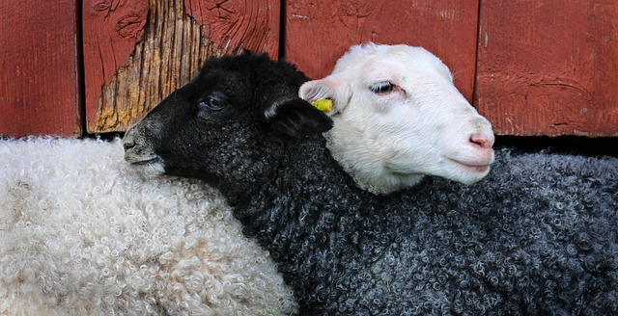
Mutual Respect
The key with mutual respect is that your
friend is into you for who you are e.g. for
your great sense of humour, your love of
soaps etc.
Does your friend listen when you say
you're not comfortable doing something
and then back off right away?
Respect in a relationship means that both people value who the other person is and understand without challenging the other person's boundaries.

Slide 4

Honesty
This one goes hand-in-hand with trust
because it's tough to trust someone when
one of you isn't being honest.
Have you ever caught your friend out?
For example, they told you that they had
to go to their dad’s on Friday night but it
turned out they were at the cinema with
some other friends?
The next time they say they’re at their dad’s, you'll have a lot more trouble believing them!

Slide 5

Support
It's not just in bad times that your friend
should support you.
Some people are great in a crisis when
your whole world is falling apart but they
don’t like it when things are going right
for you (or vice versa).
In a healthy relationship, the other
person is there for you with a shoulder to
cry on when you find out your parents are getting divorced and to celebrate with you when you get the lead part in the school play.

Slide 6
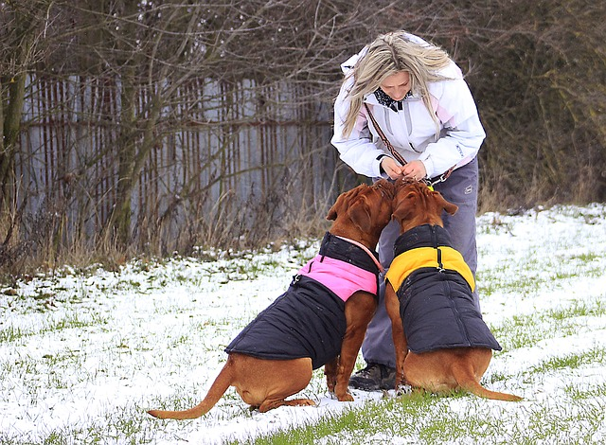
Fairness
Do you take turns choosing which game
to play on the XBox?
Do you watch films that you both want to
see?
Give and take is necessary in healthy
relationships.
If a relationship turns into a power
struggle, with one person fighting to get
his or her way all the time, then pretty soon it’ll all fall apart.

Slide 7
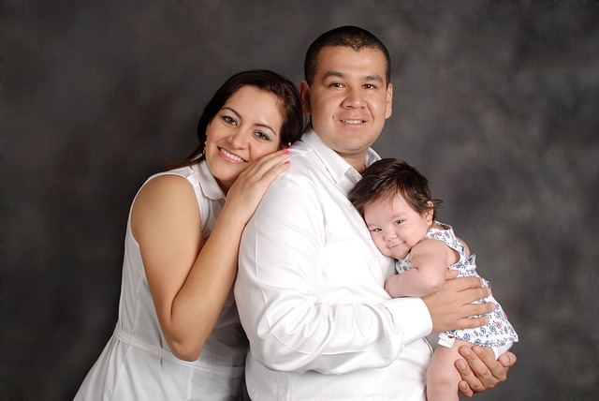
Your Own Identity
In a healthy relationship, you should be
able to be yourself.
You both have your own lives (families,
friends, interests, hobbies, etc.) and that
shouldn't change. Neither of you should
have to pretend to like something you
don't, or give up seeing other friends, or
drop out of activities you love.
You should also feel free to develop new hobbies or interests and make new friends. Give and take is necessary in healthy relationships.

Slide 8
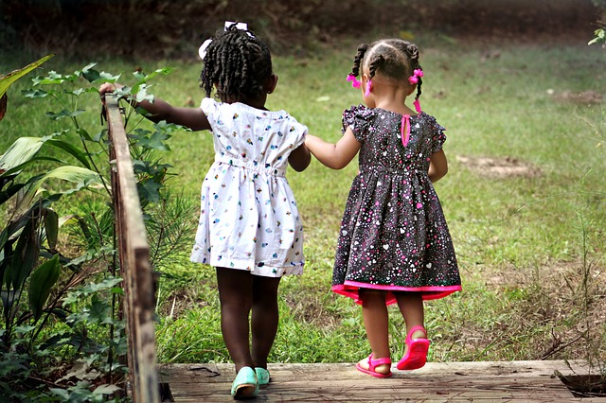
Communication
“I’m fine!” We’ve all heard that phrase so
many times when clearly the person we
are asking isn’t fine at all!
Miscommunication is the main reason
that relationships break down so it is very
important to be able to talk about things
in a sensible way.
Never keep a feeling bottled up because
you're afraid it's not what your friend wants to hear or because you worry about sounding silly.
In a healthy relationship, the other person will give you some time and
space to think something through before you're ready to talk about it

